Slide 1
SS ZG515 - Data Warehousing
Dr. Yashvardhan Sharma
CSIS Dept., BITS-Pilani

Slide 2
Contact Info
Email: yash@pilani.bits-pilani.ac.in
Course Web site:
http://taxila-aws.bits-pilani.ac.in/

Slide 3
Course Information
Two Lectures / Week
Saturday –4:00 – 5:00 PM
Sunday – 4:00 -5:00 PM
Total Lectures: 24 (Planned)
Text Books:
Ponniah P, “Data Warehousing Fundamentals”, John Wiley, 2003.
Kimball R, “The Data Warehouse Toolkit”, 2e, John Wiley, 2002.

Slide 4
Main Topics
Introduction & Background-Evolution of Data Processing
Motivation for Data Warehousing
Architecture
Data Modeling-De-normalization
Dimension Modeling
Extract – Transform – Load (ETL)
Data Quality Management (DQM)
On Line Analytical Processing (OLAP), Data Mining
Query Performance Enhancing Techniques-Need for speed (Parallelism, Join and Indexing techniques)
DWH Implementation steps
Complete implementation Case Studies
Research Issues

Slide 5
Why this course?
The world is changing (actually changed), either change or be left behind.
Missing the opportunities or going in the wrong direction has prevented us from growing.
What is the right direction?
Harnessing the data, in a knowledge driven economy.

Slide 6
The need
“Drowning in data and starving for information”
-John Naisbett
Knowledge is power, Intelligence is absolute power!

Slide 7
The need
$
POWER
INTELLIGENCE
KNOWLEDGE
INFORMATION
DATA

Slide 8
A producer wants to know….
Which are our lowest/highest margin customers ?
Who are my customers and what products are they buying?
What is the most effective distribution channel?
What product prom- -otions have the biggest impact on revenue?
Which customers are most likely to go to the competition ?
What impact will new products/services
have on revenue and margins?

Slide 9
Data, Data everywhere yet ...
I can’t find the data I need
data is scattered over the network
many versions, subtle differences
I can’t get the data I need
need an expert to get the data
I can’t understand the data I found
available data poorly documented
I can’t use the data I found
results are unexpected
data needs to be transformed from one form to other

Slide 10
What is a Data Warehouse?
A single, complete and consistent store of data obtained from a variety of different sources made available to end users in a what they can understand and use in a business context.
[Barry Devlin]

Slide 11
What are the users saying...
Data should be integrated across the enterprise
Summary data has a real value to the organization
Historical data holds the key to understanding data over time
What-if capabilities are required

Slide 12
What is Data Warehousing?
A process of transforming data into information and making it available to users in a timely enough manner to make a difference
[Forrester Research, April 1996]
Information
Data

Slide 13
Background
1980’s to early 1990’s
Focus on computerizing business processes
To gain competitive advantage
By early 1990’s
All companies had operational systems
It no longer offered any advantage
How to get competitive advantage??

Slide 14
OLTP Systems: Primary Purpose
Run the operations of the business
For example: Banks, Railway reservation etc.
Based on ER Data Modeling
Transaction based system
Data is always current valued
Little history is available
Data is highly volatile
Has “Intelligent keys”

Slide 15
OLTP Systems
Has relational normalized design
Redundant data is undesirable
Consists of many tables
High volume retrieval is inefficient
Optimized for repetitive “narrow” queries
Common data in many applications

Slide 16
Need for Data Warehousing
Companies, over the years, gathered huge volumes of data
“Hidden Treasure”
Can this data be used in any way?
Can we analyze this data to get any competitive advantage?
If yes, what kind of advantage?

Slide 17
Benefits of Data Warehousing
Allows “efficient” analysis of data
Competitive Advantage
Analysis aids strategic decision making
Increased productivity of decision makers
Potential high ROI
Classic example: Diaper and Beer

Slide 18
Decision Support Systems, DW, & OLAP
Information technology to help the knowledge worker (executive, manager, analyst) make faster and better decisions.
Data Warehouse is a DSS
A data warehouse is an architectural construct of an information system that provides users with current and historical decision support information that is hard to access or present in traditional operational systems.
Data Warehouse is not an Intelligent system
On-Line Analytical Processing (OLAP) is an element of DSS

Slide 19
DW: Interesting Statistics

Slide 20
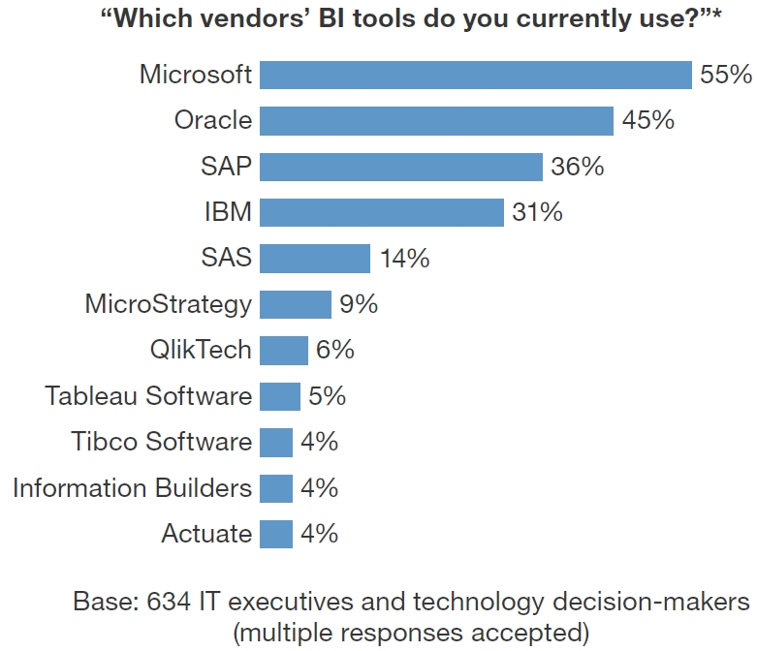

Slide 21
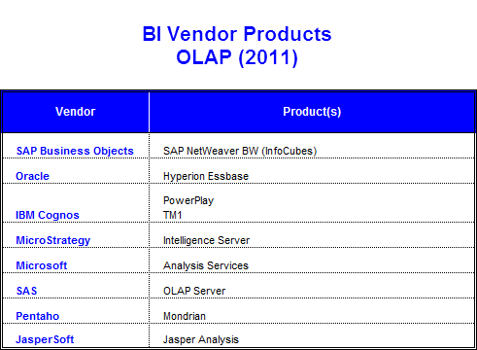
Data Warehouse: Major Players

Slide 22
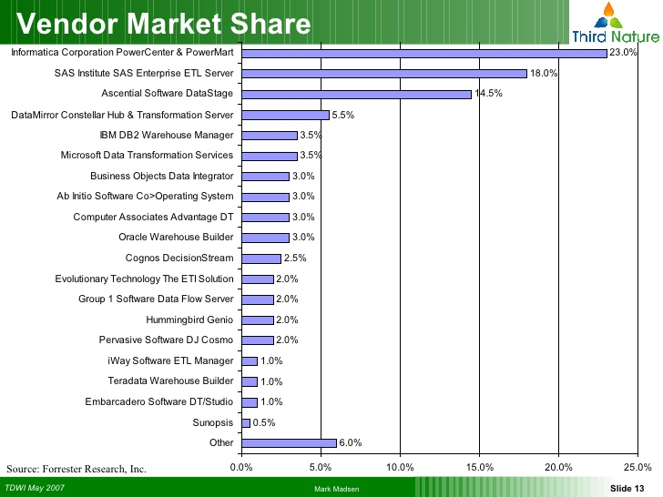

Slide 23
Data Warehouse: Characteristics
Analysis driven
Ad-hoc queries
Complex queries
Used by top managers
Based on Dimensional Modeling
Denormalized structures

Slide 24
Data Warehouse
A decision support database that is maintained separately from the organization’s operational databases.
A data warehouse is a
subject-oriented,
integrated,
time-varying,
non-volatile
collection of data that is used primarily in organizational decision making

